Slide 1
Javascript development frameworks
Angular routes, http service

Slide 2
Course objectives
Introduction to Javascript. Overview
Basic http handling
Building a web server with NodeJS
NodeJS. Request and response, HTML templates, JSON data
NodeJS routing
ExpressJS
NPM, build tools
File management. Promises
Introduction to TypeScript
Introduction to Angular 2
Angular modules, applications, components
Angular services
Angular templates
Observables in Angular
Routing in Angular

Slide 3
Learning objectives
Defining routes
Navigating through pages
Http service
Http response

Slide 4
Current state
Goal
ContactsAppComponent
ContactsListComponent
ContactDetailsComponent

Slide 5
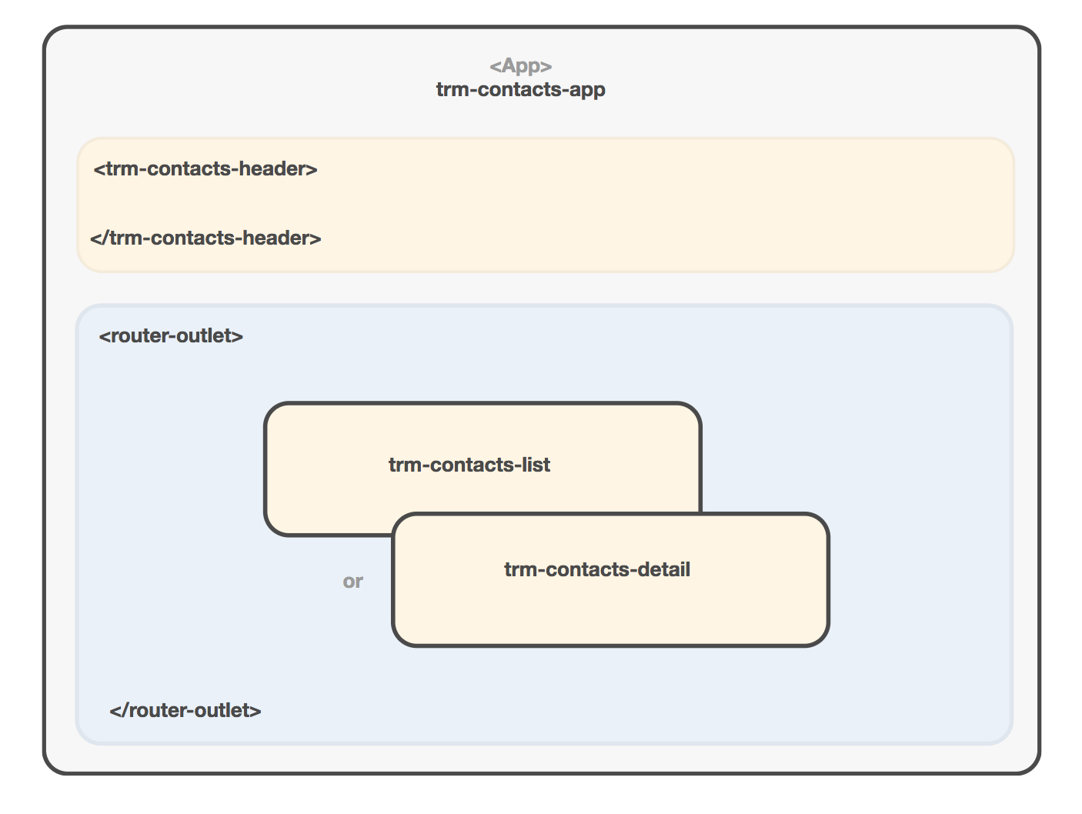
Current state

Slide 6
Defining routes
We define routes as a collection of Route objects that have a path and a component
import { ContactsListComponent } from './contacts-list';
export const APP_ROUTES = [
{ path: '', component: ContactsListComponent }
]

Slide 7
Adding Router Module
RouterModule.forRoot() configures routes for the root module of our app.
import { RouterModule } from '@angular/router';
import { APP_ROUTES } from './app.routes';
@NgModule({
imports: [ ...
RouterModule.forRoot(APP_ROUTES)
]
})
export class ContactsModule {}

Slide 8
Displaying components
<router-outlet> directive specifies a viewport where components should be loaded into
@Component({
selector: 'trm-contacts-app',
template: ` <md-toolbar>Contacts</md-toolbar>
<router-outlet></router-outlet> `,
styleUrls: ['./contacts.component.scss'] })
class ContactsAppComponent {...}

Slide 9
Links with RouterLink
RouterLink lets link to a specific part of our app
<md-nav-list>
<a md-list-item [routerLink]="['/contact', contact.id]" *ngFor="let contact of contacts">
<img src="{{contact.image}}">
<h3 md-line>{{contact.name}}</h3>
</a>
</md-nav-list>

Slide 10
Defining routes
import { ContactsListComponent } from './contacts-list';
export const APP_ROUTES = [
{ path: '', component: ContactsListComponent },
{ path: 'contact/:id', component: ContactsDetailComponent }
]

Slide 11
Retrieving parameters
import { ActivatedRoute } from '@angular/router';
@Component(...)
class ContactsDetailComponent implements OnInit { constructor(route: ActivatedRoute) {}
ngOnInit() {
let id = this.route.snapshot.params['id'];
this.contact = this.contactsService .getContact(id);
}
}

Slide 12
Http in Angular
Since 2.x Angular introduces a completely redesigned Http layer based on Observables
Event-driven stream of notifications
Enables functional programming structures
Allows to transform to promises if needed

Slide 13
Http in Angular
HttpModule configures the injector for http dependencies
import { HttpModule } from '@angular/http';
@NgModule({
imports: [
...
HttpModule
]
})
export class ContactsModule {...}

Slide 14
Http in Angular
Http is an injectable class with methods to perform http reqiuests
import { Http } from '@angular/http';
import { Injectable } from '@angular/core';
import 'rxjs/add/operator/map';
@Injectable()
class ContactsService {
constructor(private http: Http) { }
}

Slide 15
Http in Angular
Http returns an observable which will emit a single response it’s received
class ContactsService {
...
getContacts() {
return this.http.get('http://myapi.com/contacts')
.map(res => res.json())
.map(data => data.items);
}
}

Slide 16
Subscribing to Http
We can subscribe to Observables using .subscribe()
@Component(...)
class ContactsListComponent {
constructor(contactsService: ContactsService) { contactsService.getContacts()
.subscribe(contacts => this.contacts = contacts);
}
}

Slide 17
Demo

Slide 18
Tasks

